Slide 1
C Arrays

Slide 2
What is Array in C?
An array in C is a fixed-size collection of similar data items stored in contiguous memory locations.
It can be used to store the collection of primitive data types such as int, char, float, etc., and also derived and user-defined data types such as pointers, structures, etc.

Slide 3
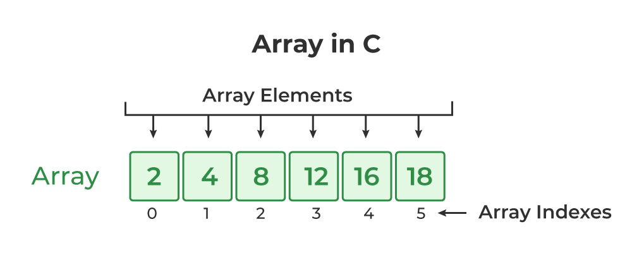

Slide 4
C Array Declaration
In C, we have to declare the array like any other variable before using it.
We can declare an array by specifying its name, the type of its elements, and the size of its dimensions.
When we declare an array in C, the compiler allocates the memory block of the specified size to the array name.

Slide 5
Syntax of Array Declaration
data_type array_name [size]; or data_type array_name [size1] [size2]...[sizeN]; where N is the number of dimensions.

Slide 6
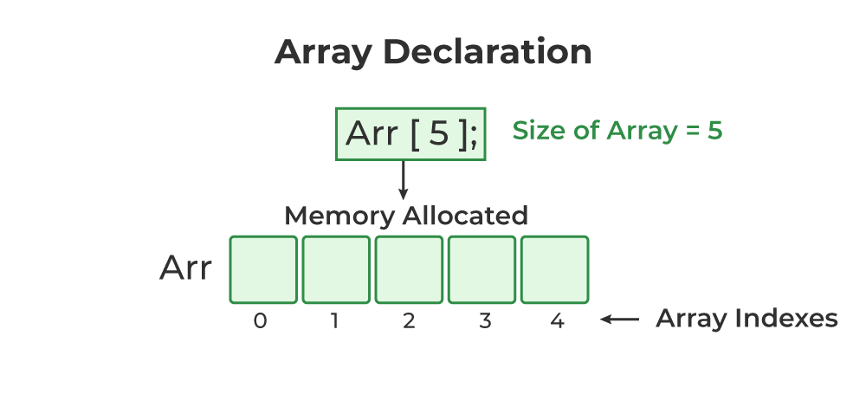
data_type array_name [size]; or data_type array_name [size1] [size2]...[sizeN];
where N is the number of dimensions.

Slide 7
Example of Array Declaration
// C Program to illustrate the array declaration
#include <stdio.h>
int main()
{
// declaring array of integers
int arrint[5];
// declaring array of characters
char arrchar[5];
return 0;
}

Slide 8
C Array Initialization
Initialization in C is assigning some initial value to the variable.
When the array is declared or allocated memory, the elements of the array contain some garbage value.
So, we need to initialize the array to some meaningful value.
There are multiple ways in which we can initialize an array in C.

Slide 9
1. Array Initialization with Declaration
In this method, we initialize the array along with its declaration.
We use an initializer list to initialize multiple elements of the array.
An initializer list is the values enclosed within braces { } separated by a comma.
data_type array_name [size] = {value1, value2, ... valueN};

Slide 10
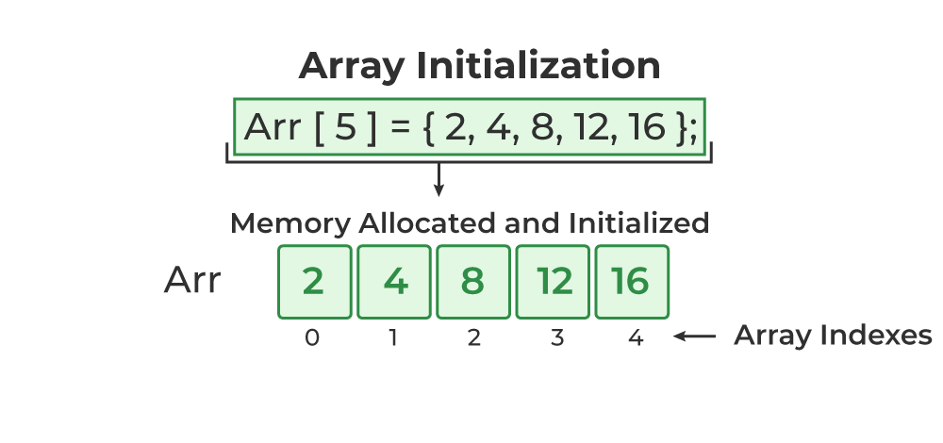

Slide 11
2. Array Initialization with Declaration without Size
If we initialize an array using an initializer list, we can skip declaring its size, as the compiler can automatically deduce its size in these cases.
The size of the array in these cases is equal to the number of elements present in the initializer list as the compiler can automatically deduce the size of the array.
data_type array_name[] = {1,2,3,4,5};
The size of the above arrays is 5 which is automatically deduced by the compiler.

Slide 12
3. Array Initialization after Declaration (Using Loops)
We initialize the array after the declaration by assigning the initial value to each element individually.
We can use the for loop, while loop, or do-while loop to assign the value to each element of the array.
for (int i = 0; i < N; i++)
{ array_name[i] = valuei; }

Slide 13
// C Program to demonstrate array initialization
#include <stdio.h>
int main()
{
// array initialization using initialier list
int arr[5] = { 10, 20, 30, 40, 50 };
// array initialization using initializer list without
// specifying size
int arr1[] = { 1, 2, 3, 4, 5 };
// array initialization using for loop
float arr2[5];
for (int i = 0; i < 5; i++) {
arr2[i] = (float)i * 2.1;
}
return 0;
}

Slide 14
Access Array Elements
We can access any element of an array in C using the array subscript operator [ ] and the index value i of the element.
array_name [index];
One thing to note is that the indexing in the array always starts with 0, i.e., the first element is at index 0 and the last element is at N – 1 where N is the number of elements in the array.

Slide 15
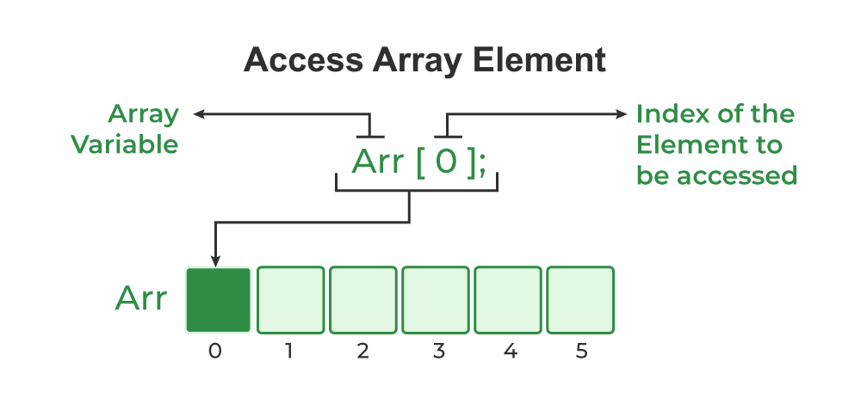

Slide 16
// C Program to illustrate element access using array
#include <stdio.h>
int main()
{
// array declaration and initialization
int arr[5] = { 15, 25, 35, 45, 55 };
// accessing element at index 2 i.e 3rd element
printf("Element at arr[2]: %d\n", arr[2]);
// accessing element at index 4 i.e last element
printf("Element at arr[4]: %d\n", arr[4]);
// accessing element at index 0 i.e first element
printf("Element at arr[0]: %d", arr[0]);
return 0;
}

Slide 17
Update Array Element
We can update the value of an element at the given index i in a similar way to accessing an element by using the array subscript operator [ ] and assignment operator =.
array_name[i] = new_value;

Slide 18
C Array Traversal
Traversal is the process in which we visit every element of the data structure. For C array traversal, we use loops to iterate through each element of the array.
Array Traversal using for Loop
for (int i = 0; i < N; i++)
{ printf(“%d”,array_name[i]; }

Slide 19
#include <stdio.h>
int main()
{
// array declaration and initialization
int arr[5] = { 10, 20, 30, 40, 50 };
// modifying element at index 2
arr[2] = 100;
// traversing array using for loop
printf("Elements in Array: ");
for (int i = 0; i < 5; i++) {
printf("%d ", arr[i]);
}
return 0;
}

Slide 20
Types of Array in C
There are two types of arrays based on the number of dimensions it has. They are as follows:
One Dimensional Arrays (1D Array)
Two Dimensional Arrays(2D Array)
Multidimensional Arrays

Slide 21
One Dimensional Array in C
The One-dimensional arrays, also known as 1-D arrays in C are those arrays that have only one dimension.
Syntax of 1D Array in C
array_name [size];

Slide 22
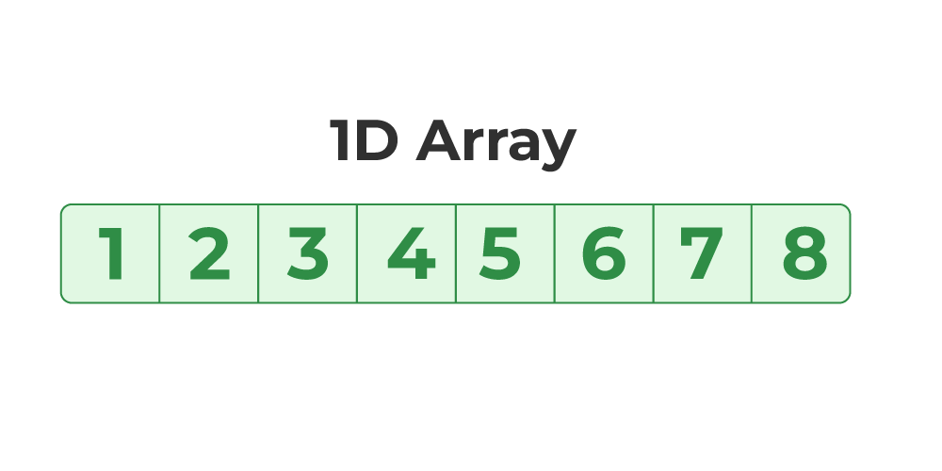

Slide 23
// C Program to illustrate the use of 1D array
#include <stdio.h>
int main()
{
// 1d array declaration
int arr[5];
// 1d array initialization using for loop
for (int i = 0; i < 5; i++) {
arr[i] = i * i - 2 * i + 1;
}
printf("Elements of Array: ");
// printing 1d array by traversing using for loop
for (int i = 0; i < 5; i++) {
printf("%d ", arr[i]);
}
return 0;
}

Slide 24
#include <stdio.h>
int main()
{ // creating array of character
char arr[6] = { 'A', 'p', 'p', 'l', 'e' };
// printing string
int i = 0;
while (arr[i])
{
printf("%c", arr[i++]);
}
return 0;}

Slide 25
Two-Dimensional Array in C
A Two-Dimensional array or 2D array in C is an array that has exactly two dimensions.
They can be visualized in the form of rows and columns organized in a two-dimensional plane.
Syntax of 2D Array in C
array_name[size1] [size2]; Here,
size1: Size of the first dimension.
size2: Size of the second dimension.

Slide 26
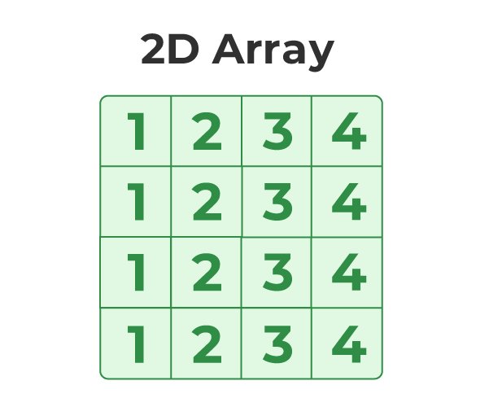

Slide 27
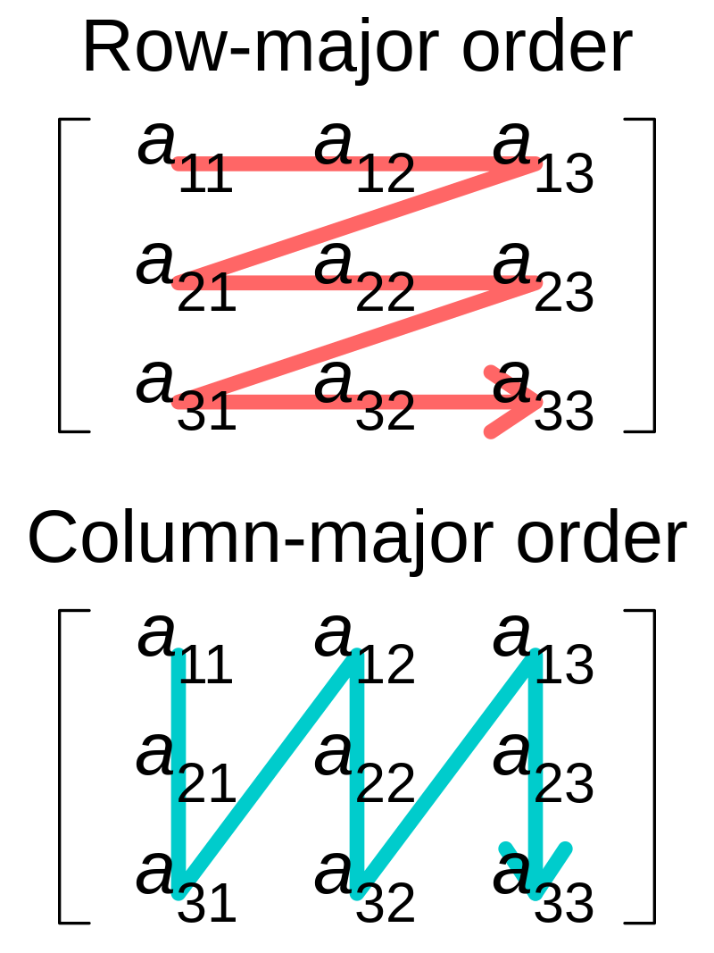
Storing multidimensional arrays
In computing, row-major order and column-major order are methods for storing multidimensional arrays in linear storage such as random access memory.

Slide 28

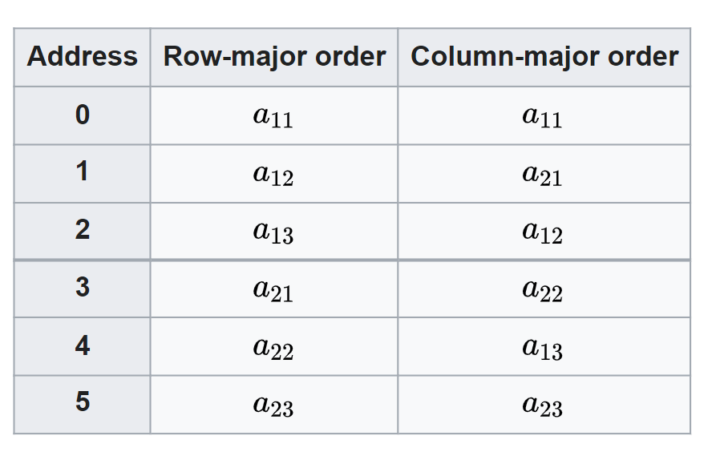
Storing multidimensional arrays

Slide 29
// C Program to illustrate 2d array
#include <stdio.h>
int main()
{
// declaring and initializing 2d array
int arr[2][3] = { 10, 20, 30, 40, 50, 60 };
printf("2D Array:\n");
// printing 2d array
for (int i = 0; i < 2; i++) {
for (int j = 0; j < 3; j++) {
printf("%d ",arr[i][j]);
}
printf("\n");
}
return 0;
}

Slide 30
Three-Dimensional Array in C
Another popular form of a multi-dimensional array is Three Dimensional Array or 3D Array.
A 3D array has exactly three dimensions.
It can be visualized as a collection of 2D arrays stacked on top of each other to create the third dimension.

Slide 31
Syntax of 3D Array in C
array_name [size1] [size2] [size3];

Slide 32
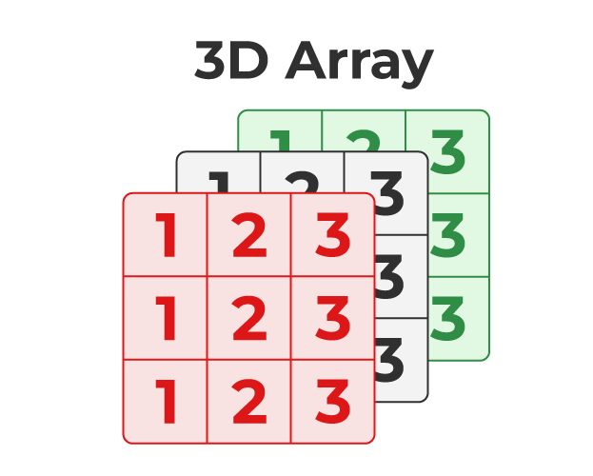

Slide 33
// C Program to illustrate the 3d array
#include <stdio.h>
int main()
{
// 3D array declaration
int arr[2][2][2] = { 10, 20, 30, 40, 50, 60 };
// printing elements
for (int i = 0; i < 2; i++) {
for (int j = 0; j < 2; j++) {
for (int k = 0; k < 2; k++) {
printf("%d ", arr[i][j][k]);
}
printf("\n");
}
printf("\n \n");
}
return 0;
}

